Slide 1
Bioinformatics Protein Structure
Assoc. Prof. Dr. Gazi Erkan BOSTANCI
Slides are mainly based on ‘Understanding Bioinformatics’ by Marketa Zvelebil and Jeremy O. Baum

Slide 2
If there is one class of molecules which could be said to live life it would be the proteins.
They are responsible for catalyzing almost all the chemical reactions in the cell (RNA has a more limited but important role, as we saw earlier), they regulate all gene activity, and they provide much of the cellular structure.
There is speculation that life may have started with nucleic acid chemistry only, but it is the extraordinary functional versatility of proteins that has enabled life to reach its current complex state.

Slide 3
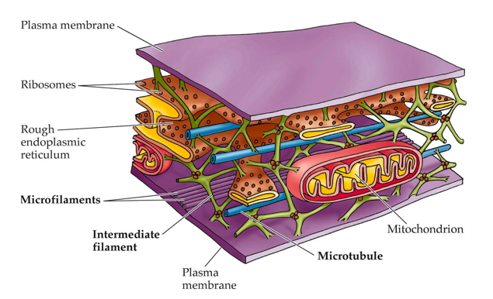
Proteins can function as enzymes catalyzing a wide variety of reactions necessary for life, and they can be important for the structure of living systems, such as those proteins involved in the cytoskeleton.
The size of a protein can vary from relatively small to quite large macromolecules.
*Cytoskeleton is the skeleton for a cell and maintains the shape of a cell.

Slide 4
The DNA sequence of a gene can be analyzed to give the amino acid sequence of the protein product. In that aspect alone, the ready availability of DNA sequences of genes and whole genomes from the 1980s onward revolutionized biology, as it opened up this vital shortcut to determining the amino acid sequence of virtually any protein.
Bioinformatics uses this sequence information to find related proteins and thus gather together knowledge that can help deduce the likely properties of unknown proteins, plus their structures and functions.
Knowing the relationship between a protein’s structure and its function provides a greater understanding of how the protein works, and thus often enables the researcher to propose experiments to explore how modifying the structure will affect the function.

Slide 5
Primary and Secondary Structure
A protein folds into a three-dimensional structure, which is determined by its protein sequence. The fold of the protein consists of repeating structural units called secondary structures, that will be discussed in this section (see Flow Diagram).
The fold of the protein is very important for the way the protein will function, and whether it will function correctly.
Therefore the study of the ways in which proteins fold and understanding how they fold is an important area of bioinformatics, as well as predicting the fold of a protein from its sequence.

Slide 6
Protein structure can be considered on several different levels
The analysis of protein structure by experimental techniques such as X-ray crystallography and nuclear magnetic resonance (NMR) has shown that proteins adopt distinct structural elements.
In general there are four levels of protein structure to consider.

Slide 8
The primary structure is the protein sequence, the types and order of the amino acids in the protein chain.
The secondary structure is the first level of protein folding, in which parts of the chain fold to form generic structures that are found in all proteins.
The tertiary structure is formed by the further folding and packing together of these elements to give the final three-dimensional conformation unique to the protein.
Many functional proteins are formed of more than one protein chain, in which case the individual chains are called protein subunits. The subunit composition and arrangement in such multisubunit proteins is called the quaternary conformation.

Slide 9
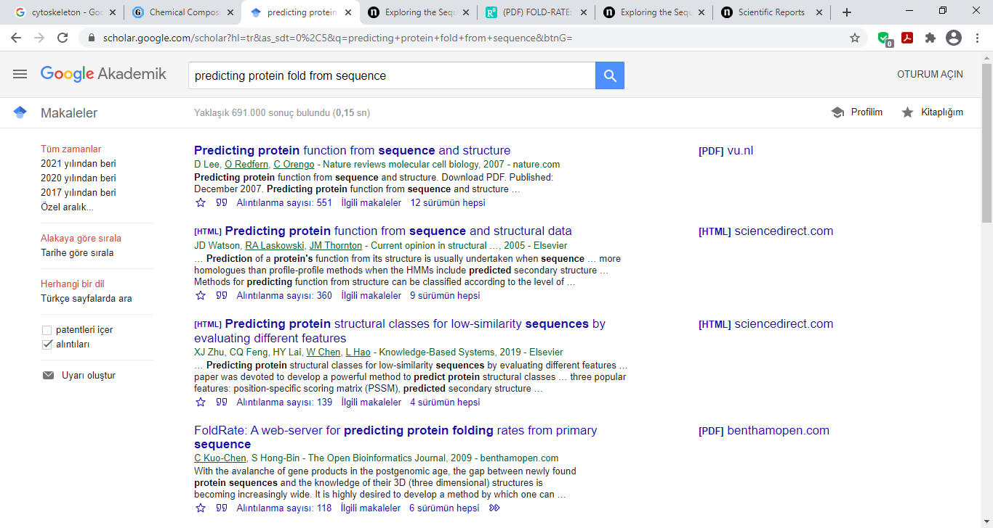
The structure adopted by a protein chain, and thus its function, is determined entirely by its amino acid sequence, but the rules that govern how a protein chain of a given sequence folds up are not yet understood and it is impossible to predict the folded structure of a protein de novo from its amino acid sequence alone.
–There are several studies on this, including recent ones.
Helping to solve this problem is one of the challenges facing bioinformatics.

Slide 10
Amino acids are the building blocks of proteins
Proteins are made up of 20 types of naturally occurring amino acids, with a few other amino acids occurring infrequently.
These 20 amino acids consist solely of the elements carbon (C), nitrogen (N), oxygen (O), and hydrogen (H), with the exception of cysteine and methionine, which also contain sulfur (S).
The structure of an amino acid can be divided into a common main chain part and a side chain that differs in chemical structure among the different amino acids. The side chain is attached to the main chain carbon atom known as the α-carbon (Cα).

Slide 11
Diagram of an amino acid.
(A) shows the chemical structure of two amino acids, where R represents the side chains, which can be different as shown in (B).
The amino acid consists of a central Cα atom with a main chain N and C at either side of it. The C is bonded to an O with a double bond.

Slide 13
The differing chemical and physical properties of amino acids are due to their side chains
The functional properties of proteins are almost entirely due to the side chains of the amino acids. Each type of amino acid has specific chemical physical properties that are conferred on it by the structure and chemical properties of its side chain.
They can, however, be classified into overlapping groups that share some common physical and chemical properties, such as size and electrical charge.

Slide 14
The smallest amino acid is glycine, which has only a hydrogen atom as its side chain. This endows it with particular properties such as great flexibility.
The other extreme of side-chain flexibility is represented by proline, an amino acid that has a side chain bonded to the main-chain nitrogen atom, resulting in a rigid structure.

Slide 15
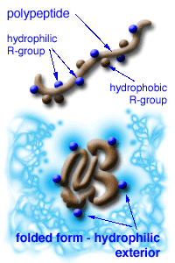
Some amino acids have uncharged side chains and these are generally hydrophobic (not liking water, therefore tend to be buried within the protein surrounded by other hydrophobic amino acids) while others are positively or negatively charged.
The charged or polar amino acids are hydrophilic; they like to be surrounded by water molecules with which they can form interactions.

Slide 16
As there are 20 distinct amino acids that occur in proteins, there can be 20^{n} different polypeptide chains of length n.
For example, a polypeptide chain 250 amino acids in length will be one of more than 10³²⁵ alternative different sequences.
Clearly, the sequences that do occur are only a tiny fraction of those possible. Often only a few sequence modifications are needed to destabilize the three-dimensional conformation of a protein, and so it is probable that the majority of these alternative sequences will not adopt a stable conformation.

Slide 17
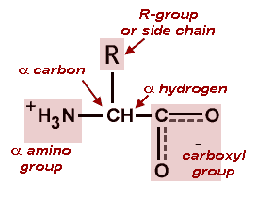
Amino acids are covalently linked together in the protein chain by peptide bonds
The primary structure of a protein is the sequence of amino acids in the linear protein chain, which consists of covalently linked amino acids. This linear chain is often called a polypeptide chain.
The amino acids are linked by peptide bonds, which are formed by a condensation reaction (the loss of a water molecule) between the backbone carboxyl group of one amino acid and the amino group of another.
When linked together in this way, the individual amino acids are conventionally called amino acid residues.
Amino acid structure

Slide 18
Peptide bonds.
(A) gives the chemical formulae of the peptide bond that is formed between amino acids to make a polypeptide chain.
(B) illustrates the above in a diagrammatic form.

Slide 19
Implication for Bioinformatics
In part, bioinformatics concerns itself with the analysis of protein sequence to predict the secondary structure, the tertiary structure, and the function of the protein, as well as its relationship to other proteins.
Different secondary structures tend to have subtle differences in chemical environments, resulting in amino acid preferences.
In addition, amino acid preferences are seen at particular locations in proteins due to the functional role they play, for example as catalytic residues or stabilizing the overall protein structure.

Slide 20
Evolution has aided sequence analysis
Protein sequence similarity is a powerful tool for characterizing protein function and structure since an enormous amount of information is conserved throughout the evolutionary process.
Proteins that have a common ancestor are referred to as being homologous.

Slide 21
Sequence alignment and database search techniques can identify homologous proteins.
Homologous proteins usually have a similar three-dimensional structure with related active sites and binding domains. Therefore homologous proteins will also often have related functions, although this is not always the case.
Most amino acids that change during evolution are found in regions that are not structurally or functionally important, such as many of the loops (or variable) regions.
If the homologous protein is also functionally related then the amino acids involved in function are often conserved during evolution, which helps in identifying the function of a new protein.

Slide 22
Visualization and computer manipulation of protein structures
There are a number of programs available that read the coordinate file and convert it to a visible three-dimensional representation of the protein. The protein can be rotated, specific regions highlighted, and some measurements can be calculated.
Some of these programs are very powerful and can be of great use in analyzing the structural properties and molecular function, as well as allowing for the manual modification of the molecule.
Some of the programs are free or low cost, such as Chimera, Yasara, and DeepView. Others are extremely powerful programs that allow the user to carry out computationally intensive modifications to the molecule, but are expensive.

Slide 23
Molecular representations.
The different representations that can be used to illustrate molecules, from very simple ones that only use the Cα or backbone atoms to spacefilling models of all atoms in the structure.

Slide 24
There are many styles for viewing molecular structures, including those with atomic-level detail such as space-filling models, ball and stick models, and wireframe models (also called stick models or skeletal models), as well as surface models.
However, it is often desirable to have a simplified model of the protein, such as backbone or Cα models and schematic (cartoon) models. Such models can be represented on a computer screen and can be represented in different styles and colors.
Molecular models are usually based upon an atomic coordinate file, which in general give the (x,y,z) coordinates of each atom.

Slide 25
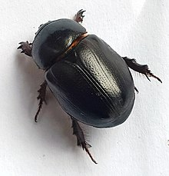
ChimeraX demonstration
2bbv.pdb (Black beetle virus, RNA virus)
Heteronychus arator

